Slide 1


Water Justice
Speakers Bureau
Presentation by Majestic Moerland
Notes:
Introduce yourself, share your connection to the land you reside on and your relationship with water.

Slide 2
Mercury Poisoning
in Grassy Narrows
(Asubpeeschoseewagong)
Notes:
This presentation will discuss Mercury Poisoning in Grassy Narrows also known as Asubpeeschoseewagong
In the 1960s a papermill had dumped tons of mercury into the nearby waterway. This contaminated the waters, polluting them, impacting the fish and the locals. This community continues to face mercury poisoning today from actions in 1960.
Together today we will learn some more together about mercury poisoning in Grassy Narrows.
Warning: this presentation does discuss topics of grief, death, and suicide.
Mental health resources should be made available and accessible for everyone in the class.
If you do not wish to discuss mental health impacts, please skip over slide 21.

Slide 3

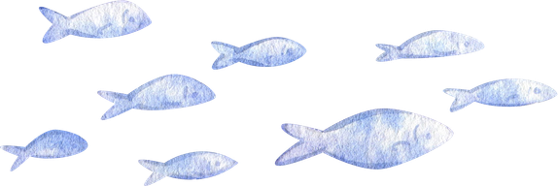
What is Bioaccumulation?
What is Biomagnification?
Notes:
Let's start with some vocabulary.
What is Bioaccumulation?
What is Biomagnification?
(Interact with students, write answers on board if available)
*Answers on following slide*

Slide 4
What is Bioaccumulation?
What is Biomagnification?
Accumulation of contaminants in an organism, possibly from the environment and diet
An increase in concentration of a contaminant as it passes along trophic levels in a food chain
Notes:
Bioaccumulation and biomagnification are both concerns for human health. Chemicals and toxins could bioaccumulate in organisms and proceed to biomagnification as it travels up the food chain (Tucker et al, 2025). Mercury concentrations are higher in predators who are at the top of the food chain in comparison to some organisms at the very bottom (Government of Canada).
Bioaccumulation is the accumulation of contaminants such as mercury in an organism; this can be from the environment they live in, or their diet (Ali and Khan 2019, 1358).
Biomagniﬁcation is an increase in concentration of a contaminant as it passes along trophic levels in a food chain (Ali and Khan, 2019, 1358).

Slide 5
What are Trophic Levels?
Notes:
What are Trophic Levels?

Slide 6
What are Trophic Levels?
Trophic Levels are the level or position of an organism in the food chain. Trophic level helps to explain energy relationships between different organisms.
Notes:
Trophic Levels are the level or position of an organism in the food chain (Ocean Wise). Trophic level helps to explain energy relationships between different organisms (Ocean Wise).

Slide 7
Why would the concentration of these chemicals be higher as it moves up trophic levels of the food chain?
Notes:
QUESTION: Why would the concentration of these chemicals be higher as it moves along trophic levels of the food chain?
*The next slide picture includes brown dots on the species (plankton, small fish, big fish that increase as it goes along the food chain giving an example of how the concentration becomes higher in a species as it passes through food webs / trophic levels.*

Slide 8
Plankton
Big Fish
Notes:
We can visualize it like this: in water there are plants called plankton, they can absorb mercury compounds (BBC). As the planktons are eaten by small fish, the mercury has now been passed onto the fish (BBC). The concentration of mercury becomes higher, then bigger fish come to eat the smaller fish, same scenario occurs (BBC). Looking at one of the biggest fish, for example tuna, can be very high in mercury (BBC). We can see how this would be a concern for human health as we eat fish (BBC).
Notice on this slide how the brown dots of pollution travel throughout the food chain from smaller organisms to larger.

Slide 9
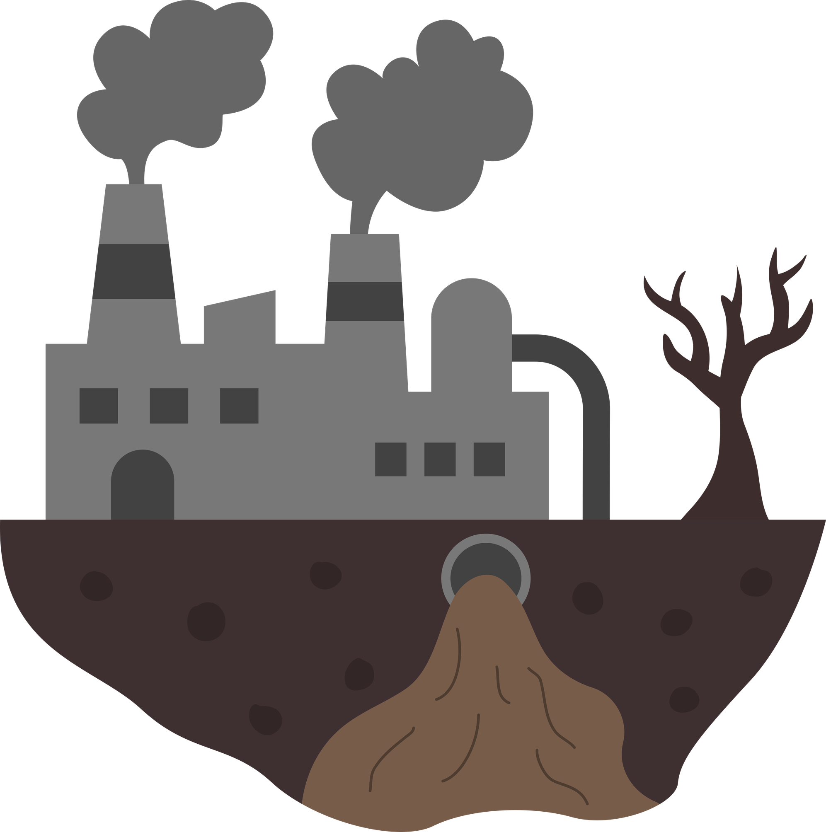
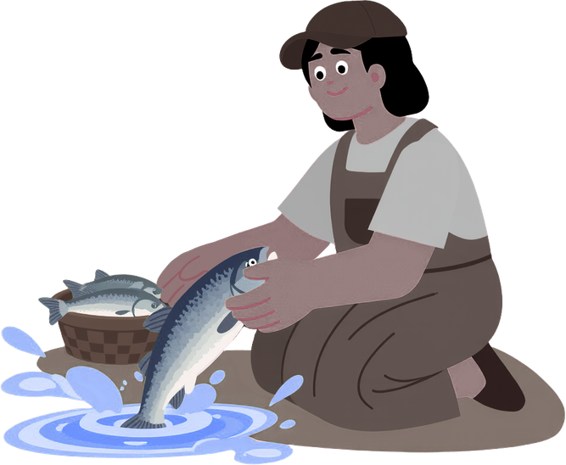
What is Trophic Transfer?
Pollution
Human
Plankton
Small Fish
Big Fish
Notes:
QUESTION: What is Trophic Transfer?
Trophic transfer is the passing of contaminants within a food chain, moving from one trophic level to the next (Ali and Khan 2019, 1358). A passage for pollutants can be visualized as our food lives and grows in a contaminated environment prior to us eating it. We must understand that trophic transfer, bioaccumulation and biomagnification of chemicals and heavy metals throughout food webs have crucial implications for wildlife health and human health (Ali and Khan, 2019, 1354).

Slide 10

What is Mercury?
Mercury occurs naturally in the environment through volcanic activity or the weathering of rocks, but it is also released into the environment through human activity.
Notes:
Through industrialization and urbanization there has been an increase in anthropogenic sources that are inputting heavy metals such as mercury into the environment (World Health Organization). These heavy metals are hazardous to the environment because they are toxic, persistent, and bioaccumulate (World Health Organization).

Slide 11


What does Anthropogenic mean?
Notes:
QUESTION: Does anyone know what anthropogenic means?

Slide 12
What does Anthropogenic mean?
Anthropogenic means something created or influenced by human beings in nature.
Our actions drive climate change and have other detrimental impacts on the environment.
Notes:
ANSWER: Anthropogenic means something created or influenced by human beings in nature (Energy Education). Our actions drive climate change and have other detrimental impacts to the environment, some of this is done through the release of greenhouse gasses (Energy Education).

Slide 13
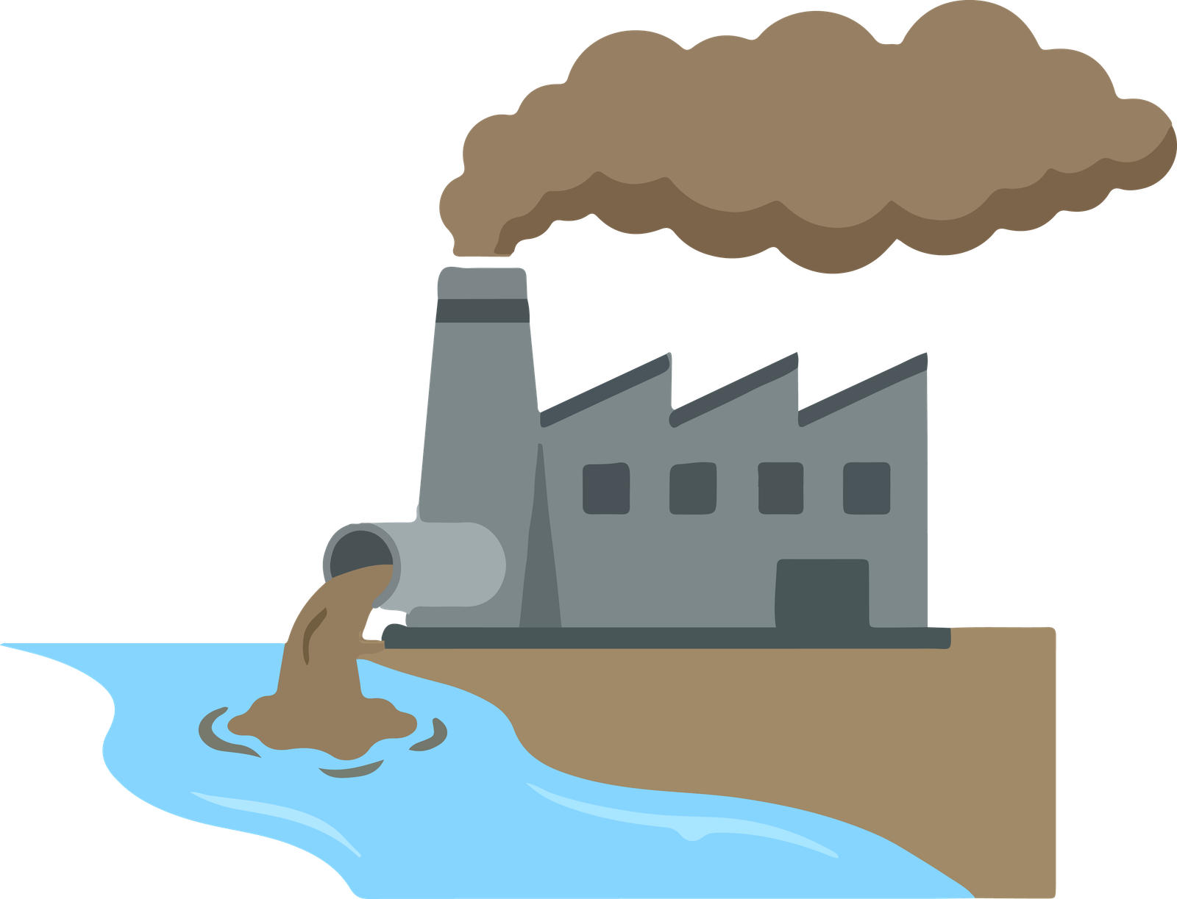
Industrialization and Urbanization
Notes:
Through industrialization and urbanization there has been an increase in anthropogenic sources that are inputting heavy metals such as mercury into the environment (World Health Organization). These heavy metals are hazardous to the environment because they are toxic, persistent, and bioaccumulate (World Health Organization).
The things we do in the environment matter, on large and small scales. Urban runoff can contribute to toxins polluting waterways, which ultimately will work its way through the food chain and back to humans (National Geographic, 1:30). There are industrial companies spilling chemicals into waterways like rivers, lakes and oceans, disregarding the impacts on the environment and the impacts that circle back to humans.

Slide 14

Check in!
What have we learned so far?
Trophic Transfer / Levels
Anthropogenic
Bioaccumulation
Biomagnification
Industrial Pollution
Notes:
Bioaccumulation:
- The accumulation of contaminants in an organism.
Biomagnification:
- An increase in concentration of contaminants as it passes along trophic levels in a food chain.
Trophic Transfer / levels:
- The transferring of contaminates through a food chain, moving from one species to the next.
Industrial pollution:
- Is pollution that is created by industry and factories, it can be very widespread. It can contaminate our environment and impact the organisms within it. Recognizing that those actions return back to impact humans in many ways.
Anthropogenic:
- Anthropogenic means something created, caused, or influenced in an environment by human activity; examples of this could be pollution or climate change.

Slide 15
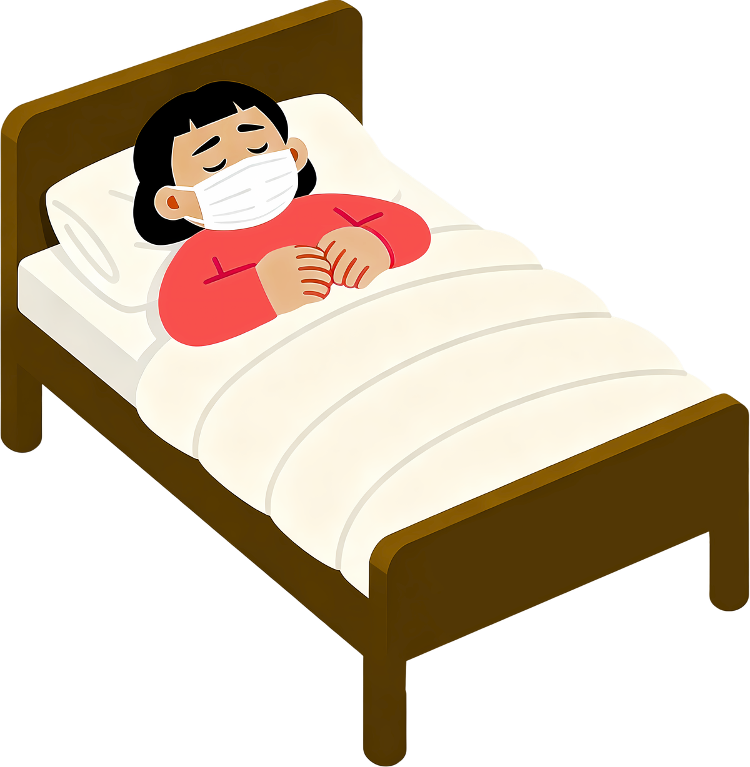
Mercury Poisoning Health Impacts
Minimata Disease: A neurological syndrome caused by intense mercury poisoning.
Some symptoms experienced by the people of Grassy Narrows:
  Cognitive delays and memory loss
  Anxiety
  Insomnia
  Numbness in fingers and toes
  Harsh headaches
  Tremors
Notes:
Exposure to heavy metals like mercury can cause autoimmunity; this is a condition where a person’s immune system starts attacking its very own cells and can cause diseases (Ali and Khan, 2019, 1354). Many effects can cause different neurological and psychological impacts consisting of personality changes, restlessness, anxiety, and tremors (Ali and Khan, 2019, 1354).
Over 90% of the community in Grassy Narrows First Nation show symptoms of mercury poisoning (Law, 2026). Some symptoms reported from the community are tremors, insomnia, memory loss, headaches, and motor dysfunction (Law, 2026).
Japanese specialists in Minamata disease, which is a neurological syndrome caused by intense mercury poisoning had come to study the people of Grassy Narrows, reporting back that many were experience symptoms such as numbness in fingers and toes, as well as cognitive delays (CBC News, 2017).
Young people in the community are severely affected by mercury poisoning, having trouble with balance, memory, coordination, and experiencing harsh headaches (Porter, n.d).

Slide 16
Dryden Paper Mill and Wayerhauser Logging Company
  In 1960 - 70s the Dryden Paper Mill dumped 9 tonnes of toxic chemical into the English-Wabigoon River System.
  Today wastewater from the mill contains sulfate and organic matter at high levels, which feeds bacteria and produces methlymercury from the inorganic mercury.
  The community is still negatively impacted by ongoing mercury poisoning in the water from the Wayerhauser Logging Company.
  This is known to be one of the worst environmental disasters in Canada.
Notes:
In the 1960s and ‘70s the Dryden Paperand organic matter at a hg the toxic waste into the environment (Ilyniak, 2014, 45). As myniak, 2014, 45).
This industrial pollution contaminated the water in Grassy Narrows, this being known as one of the worst environmental disasters in Canada (Porter, n.d).

Slide 17

Grassy Narrows
Pre-contamination, Grassy Narrows members were able to support themselves by both commercial and sport fishing.
Notes:
Grassy Narrows is located around 120 miles east of the city of Winnipeg, the English-Wabigoon river system flows through the traditional territory of the Whiskey Jack Forest (Ilyniak, 2014, 45). These lands supply the members of the community with their subsistence needs which are viewed as essential to their cultural practices and identity (Ilyniak, 2014, 45). Prior to the contamination, Grassy Narrows was able to support itself by both commercial and sport fishing (Law, 2026).
Commercial fishing remained one of the very few economic practices that are complementary to the Anishinaabe traditional ways of life, yet in 1970 the mercury poisoning caused the stop of commercial fishing on the English-Wabigoon River system (Ilyniak, 2014, 52). This caused the fishing tourism industry to crash. Mercury poisoning resulted in mass unemployment (Porter n.d)

Slide 18
History
European colonizers believed it was their right to take control of the land. Canadian Governments maintained this colonial attitude and:
  Implemented residential schools (1920's)
  Outlawed traditional practices (1930's)
  Began system of electing chiefs (1930's)
  Implemented restrictive fishing policies & practices (1940's)
  Built dams that flooded wild rice harvesting sites & burial sites (1950's)
  Allowed industry to contaminate the river, thus stopping commercial fishing in 1970
Notes:
We can’t look at the case of mercury poisoning in Grassy Narrows without looking deeper into the historically created colonial patterns that try to justify it (Ilyniak, 2014, 51).
European colonizers believed it was their God-given right to take control of the land (Ilyniak 2014, 52). The Ontario government has persisted in this attitude and tried to control the people too:
1920's: Residential Schools
1930's: discrimination of Indigenous traditional practices and beginning system of electing chiefs (not a traditional leadership system)
1940's: implemented restrictive fishing policies & practices (Ilyniak, 2014, 52).
1950's: Built dams that flooded wild rice harvesting sites & burial sites
There are many more examples!

Slide 19


Mercury Poisoning in Grassy Narrows
  Fish is a staple diet for the people of Grassy Narrows.
  Members of Grassy Narrows increasingly showed signs of mercury poisoning.
  High levels of contamination completely changed community life.
Notes:
The high levels of contamination had shifted the entire community; they had to stop commercial and tourist fishing, which was one of the last opportunities for traditional economic living (Ilyniak, 2014, 45). The Ontario Government even stated that the contaminated fish were safe for consumption; however, members of Grassy Narrows increasingly showed symptoms of mercury poisoning (Ilyniak, 2014, 45).
Humans are all exposed to some level of mercury; exposure happens mainly through inhalation of vapor during industrial processes; it can also occur through eating contaminated fish (World Health Organization). Very high concentrations of mercury in fish could lead to toxic effects on human well-being.
Fish is a staple diet for the people at Grassy Narrows, the mercury they are ingesting from the fish stays with them forever (CBC News, 2017). This mercury bioaccumulates; it is passed on to the next generation, mothers who are pregnant and are passing it to their unborn children (CBC News, 2017).

Slide 20
Mental Health Impacts
Dr. Jeffrey Ansloos has researched the impacts of water insecurity on the mental health of First Nations communities. At a vigil for Grassy Narrows members who have been harmed or died due to mercury poisoning, he said:
"What does it do to a person to be told over and over again, 'Don't drink this, but we're not gonna do anything about the conditions?' What does it do to a community when the fish relatives they've relied on for generations for food, for survival, are toxic?
What does it do to a child to grow up, knowing that the Ford government sees them as disposable? It's not just physical suffering — which it is — it's also psychological, economic, social, cultural and spiritual harm. This is what colonialism looks like."
Notes:
It's understandable how there could be psychological stress when seeing your close friends and relatives experiencing these impacts (Porter n.d)
Dr. Jeffrey Ansloos has researched the impacts of water insecurity on the mental health of First Nations communities. At a vigil for Grassy Narrows members who have been harmed or died due to mercury poisoning, he said:
"What does it do to a person to be told over and over again, 'Don't drink this, but we're not gonna do anything about the conditions?' What does it do to a community when the fish relatives they've relied on for generations for food, for survival, are toxic?
What does it do to a child to grow up, knowing that the Ford government sees them as disposable? It's not just physical suffering — which it is — it's also psychological, economic, social, cultural and spiritual harm. This is what colonialism looks like."
https://www.cbc.ca/news/canada/thunder-bay/grassy-narrows-vigil-queen-s-park-1.7468144
(Please give a warning if reviewing the next slide.
The next slide discusses mental health impacts in more detail. Trigger warning: death, grief, depression and suicide).
Please allow and mention supports available to students.

Slide 21
Mental Health Impacts
Notes:
Azraya Ackabee-Kokopenance died from suspected suicide, and her family and friends believe that grief from losing her brother Calvin to mercury poisoning can be tied to her death (Porter, n.d). Azraya’s death became an emblem of social devastation from the environmental destruction in Grassy Narrows (Porter, n.d). Healing is extremely difficult when you don’t have answers, and your pleas for help are completely ignored (Porter, n.d). This raised an alarm about mental health impacts from the mercury poisoning affecting generations of community members who were not even alive when the river originally contaminated (Porter, n.d).
Former Chief Roland Fisher of Grassy Narrows said that it is important that people see the contamination's legacy (Law, 2026).

Slide 22

Support / Aid
  Members of Grassy Narrows need to attend appointments in Winnipeg.
  Only a portion of travel is covered by medical services.
  Medical facility was promised but has been delayed for almost a decade.
  Poisoned waters still not addressed
Winnipeg
Grassy Narrows
Notes:
Health services are very limited in Grassy Narrows; there is a small nursing station; however, mental health support in the reserve is not very present (Porter, n.d.). Often members of Grassy Narrows find themselves need to go to appointments outside community, some having to travel as far as Winnipeg (Porter, n.d). There is struggle in travelling that far as medical services will only cover a portion of the travel (Porter, n.d.).
Steve Fobister a member of Grassy Narrows and former chief, is a hunter and an active advocate for his community (Porter, n.d). He has been impacted by mercury poisoning affecting his health such as issues of balance, and swallowing (Porter, n.d.). Fobister receives payments from The Mercury Disability Board of $250 a month (Porter, n.d.). This is seen as the lowest amount given by the board; this payment clearly does not suffice the cost of living (Porter n.d).
After waiting decades and pressure from First Nations and environmental groups, the Ontario Government stated they would spend $85 million on cleaning the English-Wabigoon River from the mercury contamination (Porter, n.d.). Fobister mentioned how this focus on remediating the river does not truly address the connected issues of health care (Porter, n.d).
The federal government had committed to spending millions of dollars on constructing a facility that would provide outpatient services for every community member affected by mercury poisoning (Porter, n.d.) This was originally promised back in 2017, it has been delayed far too long (Law, 2026).
Although supporting community-based care is important, some also express concern on how this specific facility doesn’t address the poisoned waters (Law, 2026).
Methods are available to reduce the impact mill operations have on the river, such as settling ponds and new environmental policies (Law 2026).

Slide 23

Environmental Injustice
Video of Judy DaSilva
Elder Judy Da Silva from Grassy Narrows explains how Indigenous people are constantly facing pollution, and while others are compensated in a timely fashion, Grassy Narrows has been experiencing negative impacts for decacdes.
Notes:
The mercury poisoning in the Anishinaabe community is an example of environmental injustice (Ilyniak, 2014, 45).
Elder Judy Da Silva from Grassy Narrows explains how Indigenous people are constantly facing pollution, always the first contacted, others are always compensated in timely fashions while Grassy Narrows has been experiencing negative impacts for decades (CBC, 2024, 1:30m). Watch here: https://www.cbc.ca/player/play/video/9.6410922
Environmental injustice can occur from environmental hazards, these a followed by actions that lack recognition on rights, or equal access to decision making. It is seen in Grassy Narrows how these factors represent how governments and corporations continue to maintain Indigenous oppression and secure the land for capitalist exploitation (Ilyniak, 2014, 46).
This case points to a human rights violation, relating to a First Nation’s right to protect their culture, health and well-being of their people, as well as their social and economic security (Law, 2024). The case in Grassy Narrows regarding the mercury poisoning is a part of the larger colonial processes in Canada (Ilyniak, 2014, 46).

Slide 24

What is Environmental Racism?
Notes:
Interact with the class, see what they think is environmental racism?
(Answers on next slide)

Slide 25
What is Environmental Racism?
“Racialized spaces are targeted with industrial hazards because the people who live there have been historically deemed unworthy of respect.” (Ilyniak, 2014, 48).
Notes:
Environmental racism mirrors environmental injustice, however, the burden groups are targeted based on race (Ilyniak, 2014, 48).
"Racialized spaces are targeted with industrial hazards because the people who live there have been historically deemed unworthy of respect.” (Ilyniak, 2014, 48).
Racism plays a large role in colonialism; environmental racism is only a small section of more complex levels of exclusion. There is limited research that focuses on Indigenous communities in Canada and the environmental injustices that these communities face.

Slide 26
Members of Grassy Narrows
Click the icon to hear from Grassy Narrows community members!
Notes:
We must understand the Grassy Narrows is not a group of one mind, they are diverse people who have varying perspectives. Some people are employed by companies that pollute the water because they need jobs, while some are protesting the actions that contaminate the water (Ilyniak, 2014, 46). Capitalist expansion is targeting culture to weaken community, Grassy Narrows’ leaders speak on the importance of cultural healing with land preservation looking forward for future generations (Ilyniak, 2014, 46).
Despite the colonial reality, some people are showing hope and determination to continue the fight to protect their lives as an autonomous nation on their traditional lands (Ilyniak, 2014, 46). Many people from Grassy Narrows share their stories about their lives and the impacts from the mercury poisoning. It is important that we listen to their voices, so we will end off with a video of Grassy Narrows community members sharing their story: https://youtu.be/9E06pWtCHIg?si=nsWxY2MATmW-ASe0

Slide 27

Kahoot!
Notes:
Let’s review what we discussed with a round of Kahoot!
(Click the Kahoot! or the icon to play)
https://create.kahoot.it/share/grassy-narrows-presentation/103dcafb-e5f4-40a6-a87e-0da3267c0ba5

Slide 28
Thank you
Miigwech!
Notes:
Thank you.
Miigwech

